Slide 1


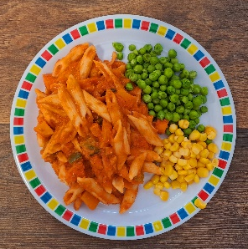




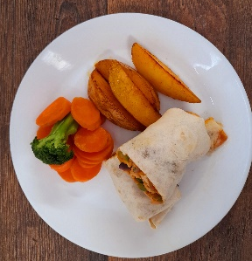
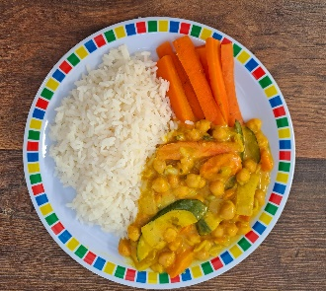
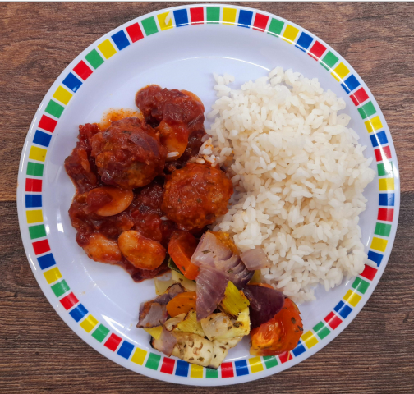


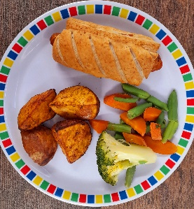

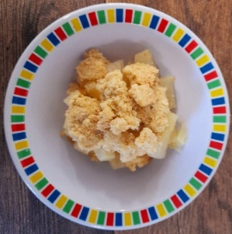

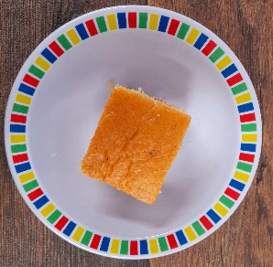
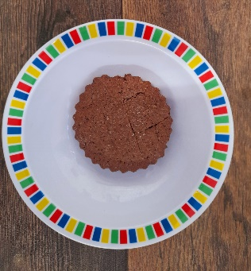

Autumn Winter 2024/2025
Tomato and Vegetable Pasta
Sausage Mash and Gravy
Roast Chicken with Roast Potatoes and Gravy
Beef Pasta Bake
Fish Fingers with Chips & Tomato Ketchup
Mexican Fajitas with Rice
NEW Creamy Curry
Vegetable Roast with Roast Potatoes and Gravy
NEW Baked Bean Hot Pot
Mexican Bean Roll with Chips and Tomato Ketchup
Melting Moment Biscuit
Apple and Blackberry Crumble with Custard
Fruit Jelly with Peaches
Winter Cake with Custard
Chocolate Orange Cookie

Slide 2
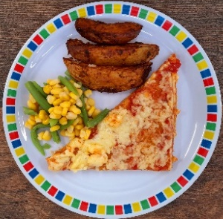

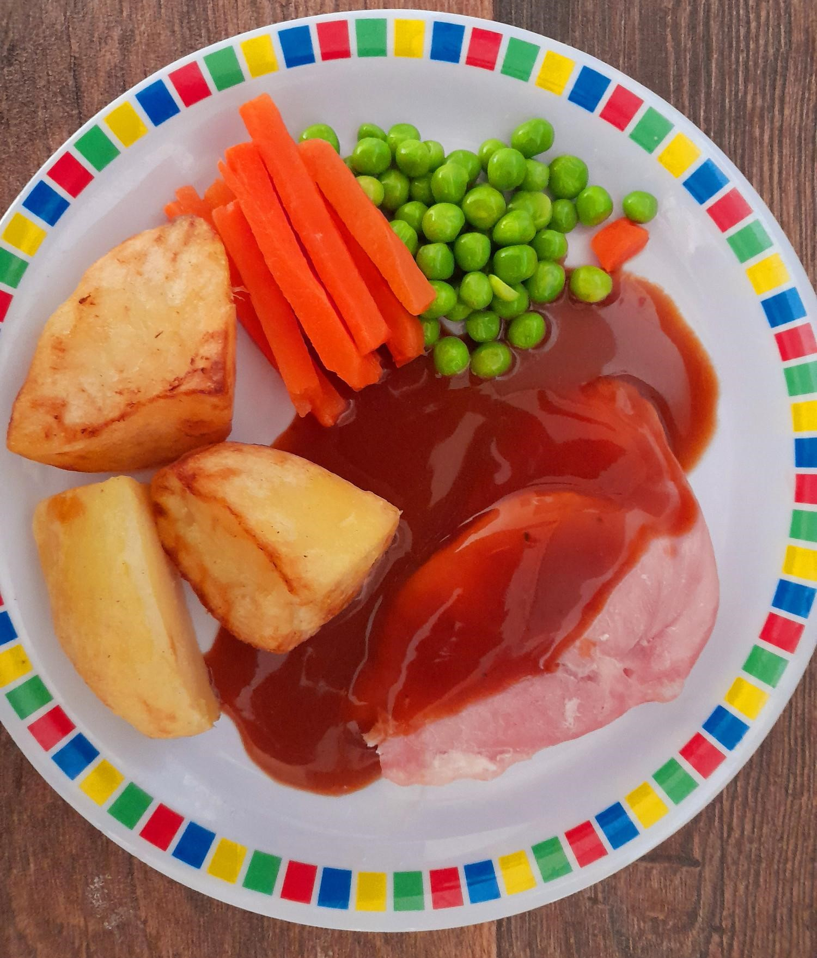
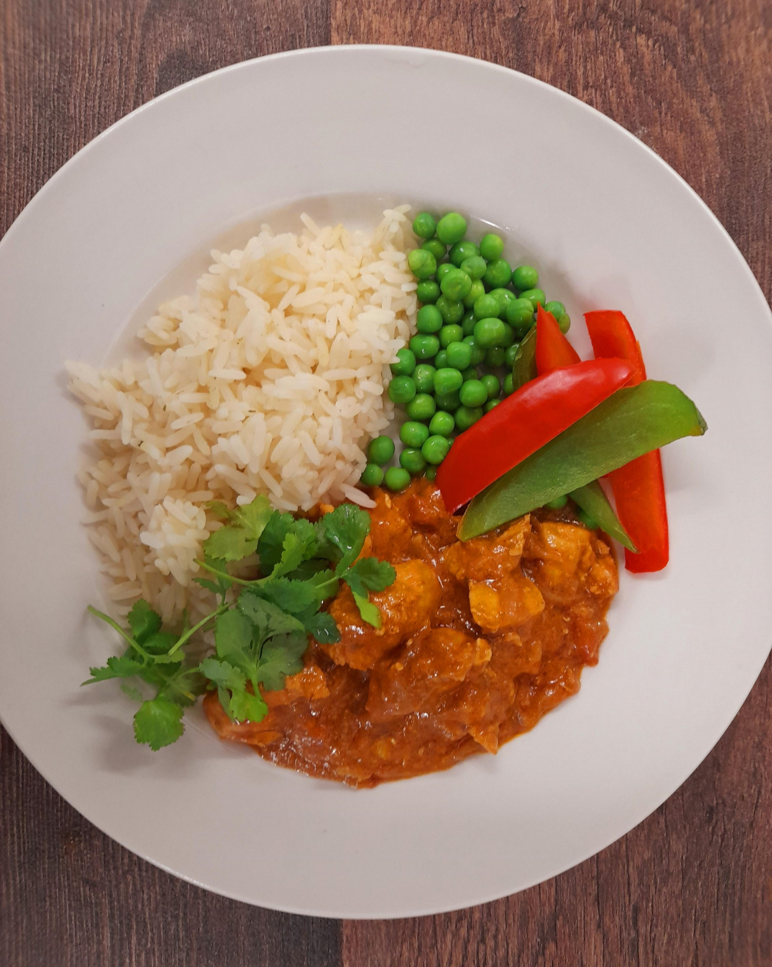
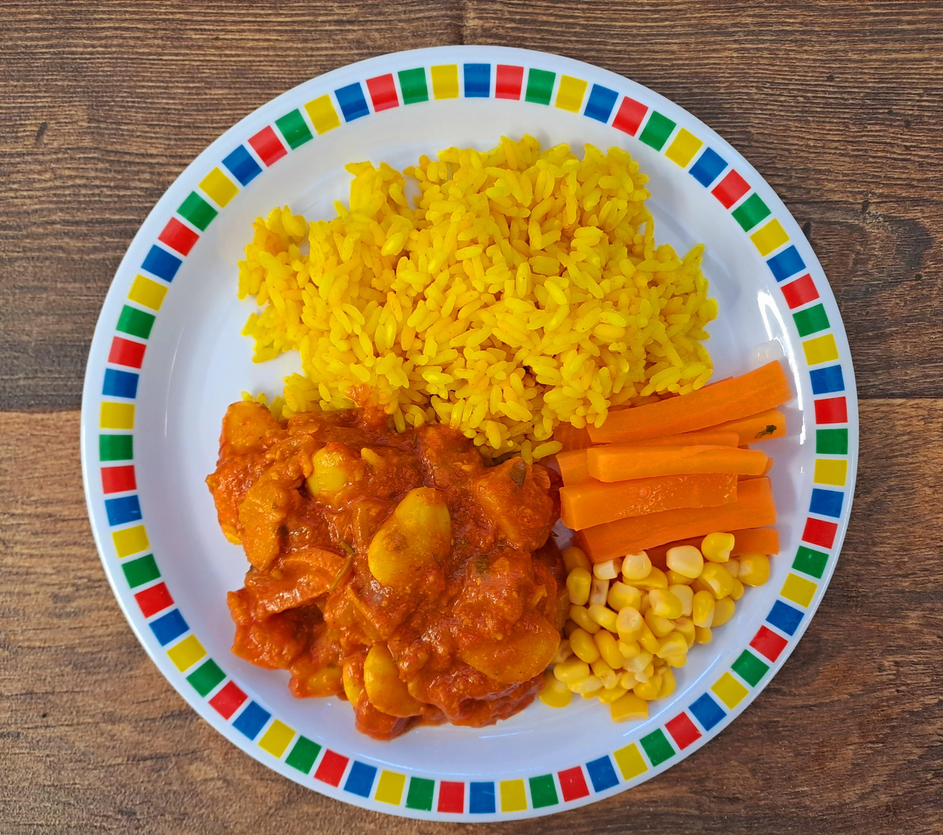
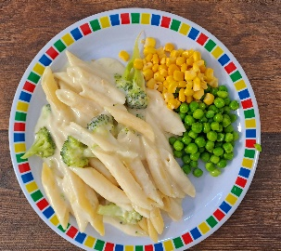

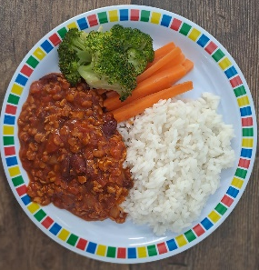
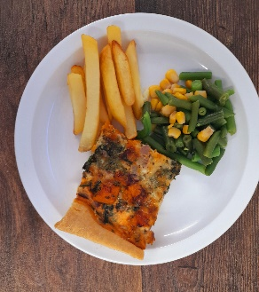





Autumn Winter 2024/2025
Classic Cheese and Tomato Pizza with New Potatoes
NEW Chicken Meatballs in Tomato Sauce with Rice
Roast Gammon with Roast Potatoes and Gravy
Chicken Tikka Masala with Rice
Fish Fingers with Chips & Tomato Ketchup
New Caribbean Stew with Rice
NEW Cheese and Broccoli Pasta with Garlic Bread
Vegan Sausages with Roast Potatoes and Gravy
NEW Mild Mexican Chilli with Rice
Cheese and Tomato Quiche with Chips and Tomato Sauce
Vanilla Shortbread
Marble Sponge Cake with Chocolate Sauce
Fruit Medley
Peach Upside down Cake with Custard
Oaty Cookie

Slide 3

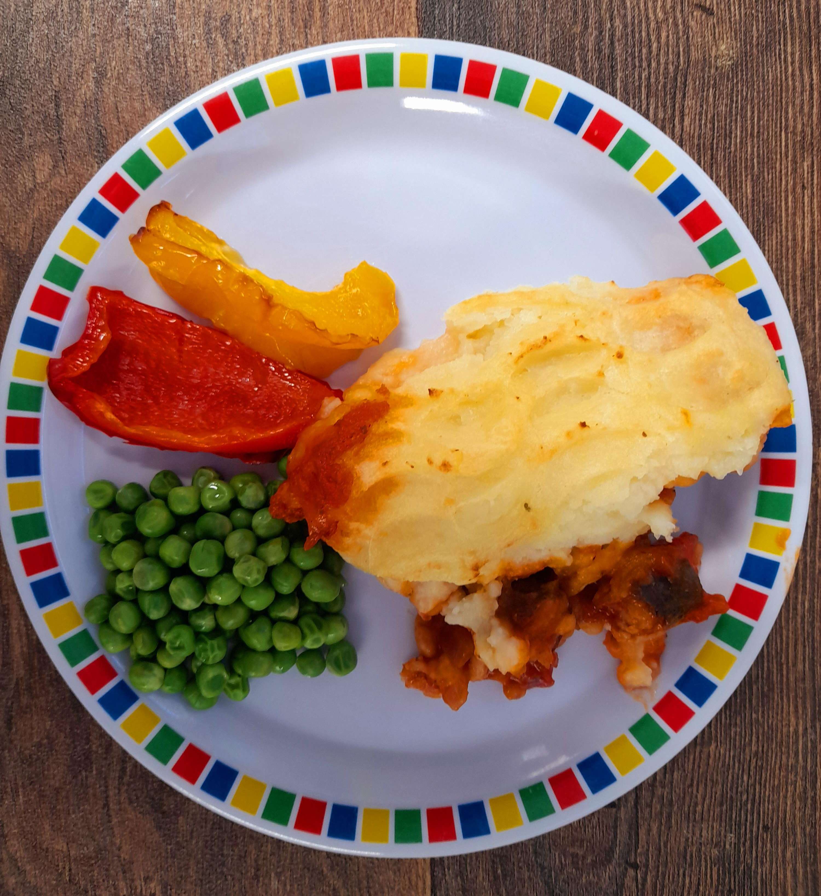

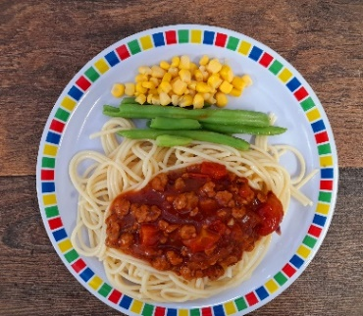

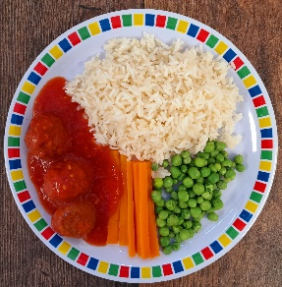

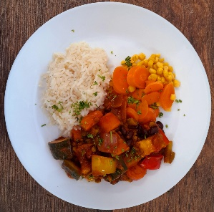


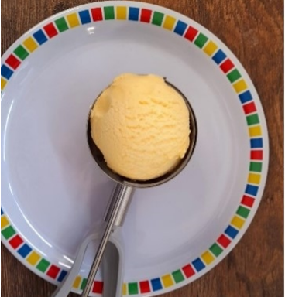


Autumn Winter 2024/2025
Macaroni Cheese
NEW Cowboy Casserole
Roast Turkey with Roast Potatoes and Gravy
Spaghetti Bolognaise with Garlic Dough Balls
Breaded Fish with Chips & Tomato Sauce
Plant Balls in Tomato Sauce with Rice
Cheese and Tomato Pizza with Wedges
Vegan Quorn with Roast Potatoes and Gravy
Chinese Vegetable Curry with Rice
Cheese & Pepper Frittata with Chips and Tomato Sauce
Chocolate Brownie
Sticky Toffee Apple Crumble with Custard
Ice Cream
Vanilla Cake with Chocolate Sauce
Cinnamon Swirl with Apple Slices

